Slide 1
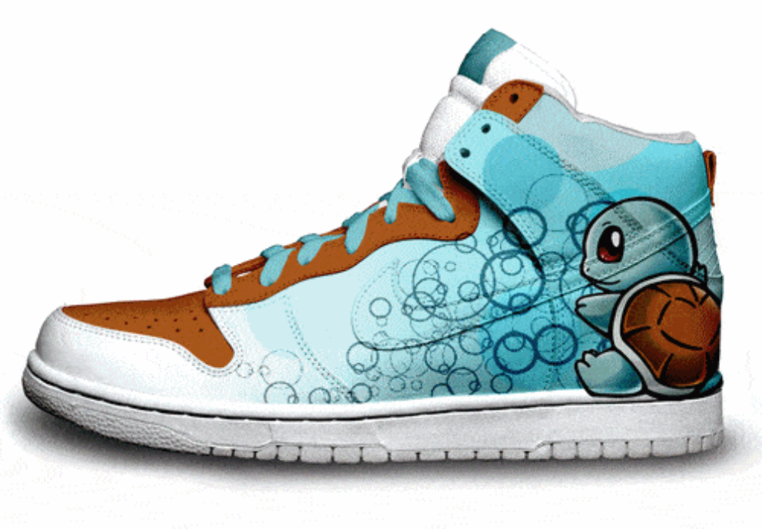
I-SHOE
-THE ONE JUST FOR YOU-

Slide 2
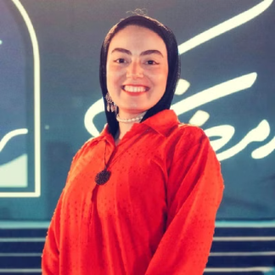
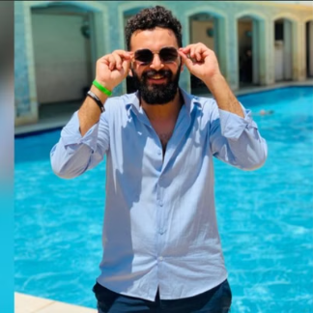


Who are we

Slide 3
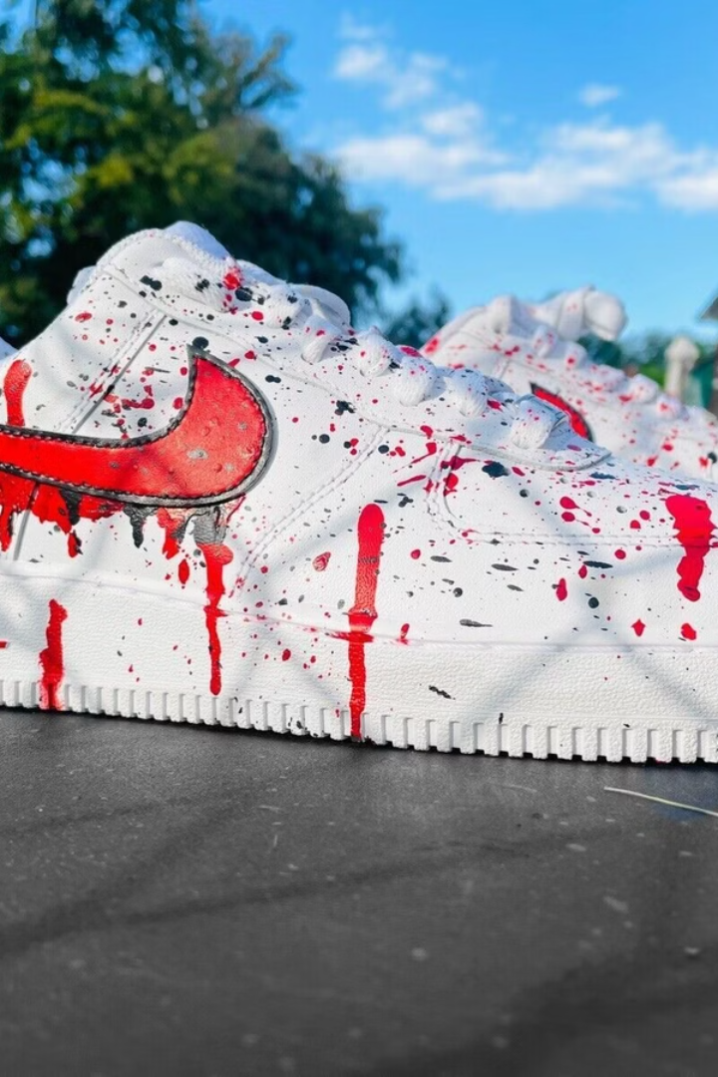
"I-SHOE"
the one just for you
I SHOE is an innovative startup that offers individuals the opportunity to design and create their own unique, comfortable, and personalized shoes and sneakers. By harnessing the power of online customization, I SHOE empowers customers to express their individuality through their footwear.

Slide 4
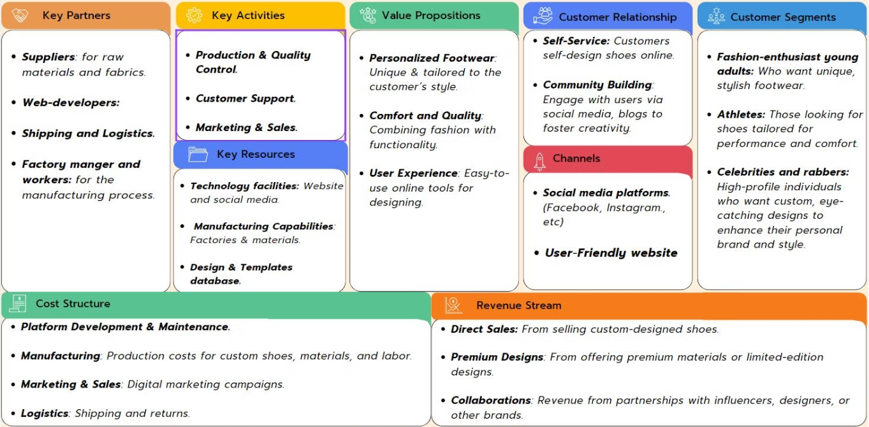
Business Model Canvas

Slide 5
SWOT Analysis
1
Strengths
2
Weaknesses
Unique and personalized product offering.
Higher price point compared to other brands.
High-quality materials.
Limited brand awareness.
The product is priced to reflect its premium quality.
Longer production times.
Limited financial recourse.
Our cooperative team work.
3
Opportunities
4
Threats
Gen Z growth, preferences, and independence
Competition from established brands.
Influencer's impact on the target audience.
Political issues and Dollar rate.
World-wide internet.
Gas and Cargo price.
Fast-changing fashion trends and customer preferences.

Slide 6

Objectives
Financial Objective:
Revenue Growth: Aim to increase total revenue by 15% by the end of Q4 through increased shoe sales and improved profit margins.
Profit Margins: Optimize manufacturing and customization costs to ensure a profit margin of at least 25% per pair sold.
Sales Target: Achieve a monthly sales target of 100 pairs of customizable shoes by leveraging eCommerce and social media platforms.
Marketing Objective:
Social Media Growth: Increase followers across key platforms (Instagram, TikTok, Facebook) by 20% over the next 3 months, targeting fashion-conscious young adults.
Posting Strategy: Maintain a consistent posting schedule with 4-5 posts per week across platforms, focusing on product highlights, customer stories, and behind-the-scenes content.
Shoe Sales: Convert social media engagement into sales, aiming for 30% of total sales to come from direct social media interactions. Income from Campaigns: Launch paid ad campaigns on Instagram and TikTok, with a target ROAS (Return on Ad Spend) of 4:1, ensuring sustainable income growth from each campaign.

Slide 7
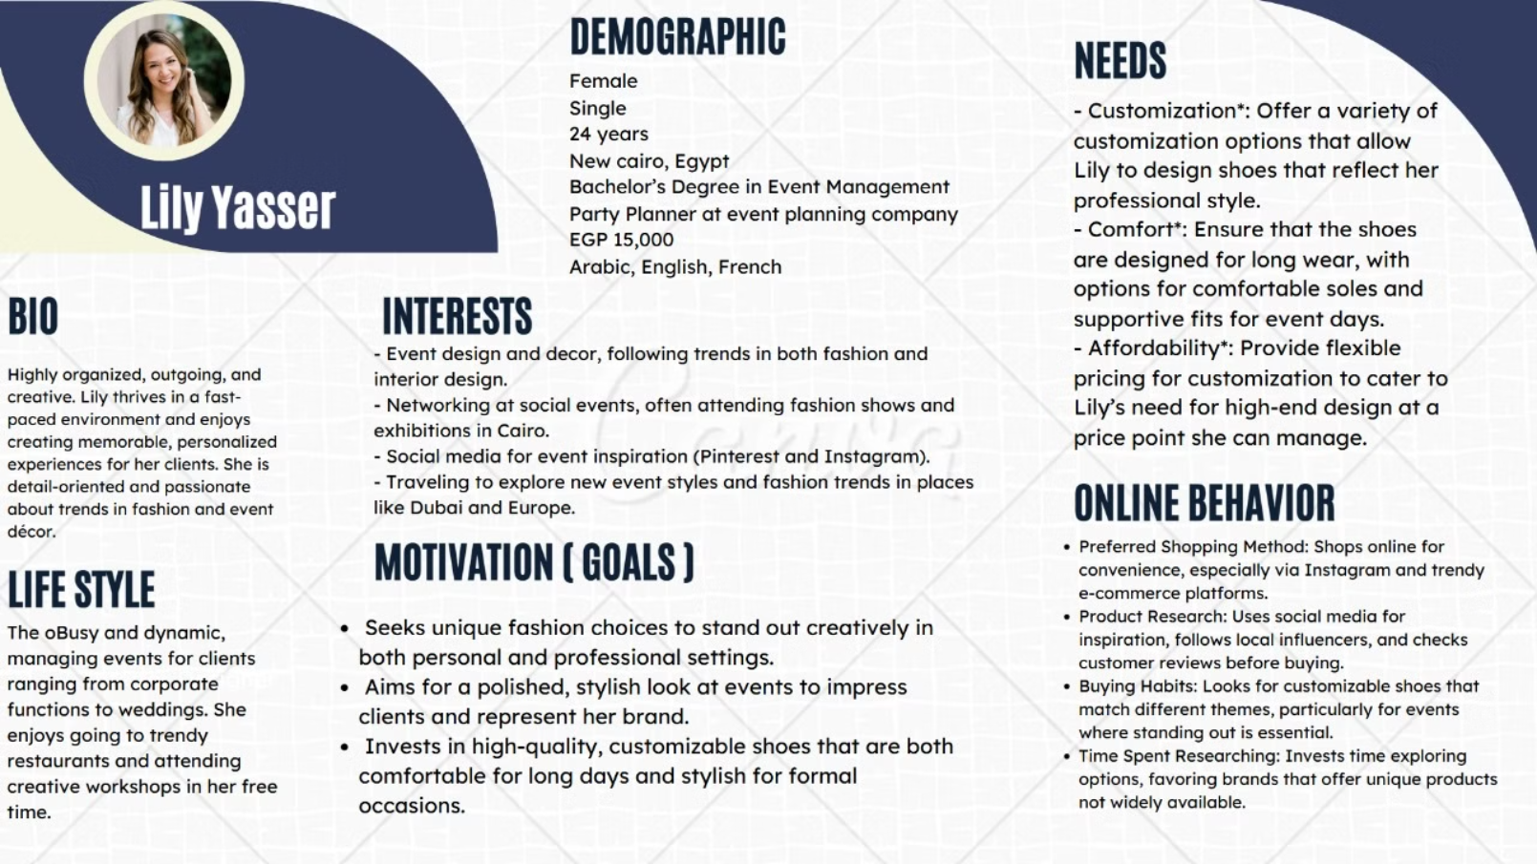
Buyer persona

Slide 8

Unique Selling Proposition
We empower customers to design their own shoes and sneakers, allowing them to express their unique style and preferences while maintaining high-quality materials and advanced production. All of this through our user-friendly online platform simplifies the customization process.

Slide 9
SMART:
Objectives: Increase brand awareness by 20% within the first 6 months.
Generate 1,000 unique visitors to the website per month within the first year.
Achieve a 15% conversion rate from website visitors to paying customers within the first year. 5.

Slide 10
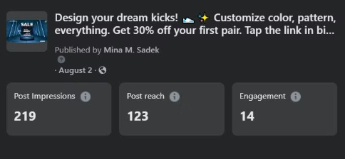
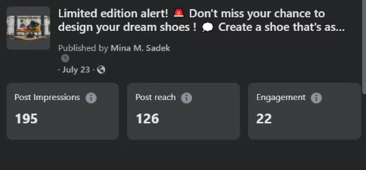
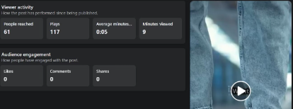
Insights:
Video and reel content have proven to be highly effective in reaching young adult athletes, as evidenced by their strong performance in terms of impressions and reach.
Link: https://web.facebook.com/reel/1025045222631236
Link: https://fb.watch/vekTZ5Z7GE/
Link: https://fb.watch/vekWVRQL29/

Slide 11

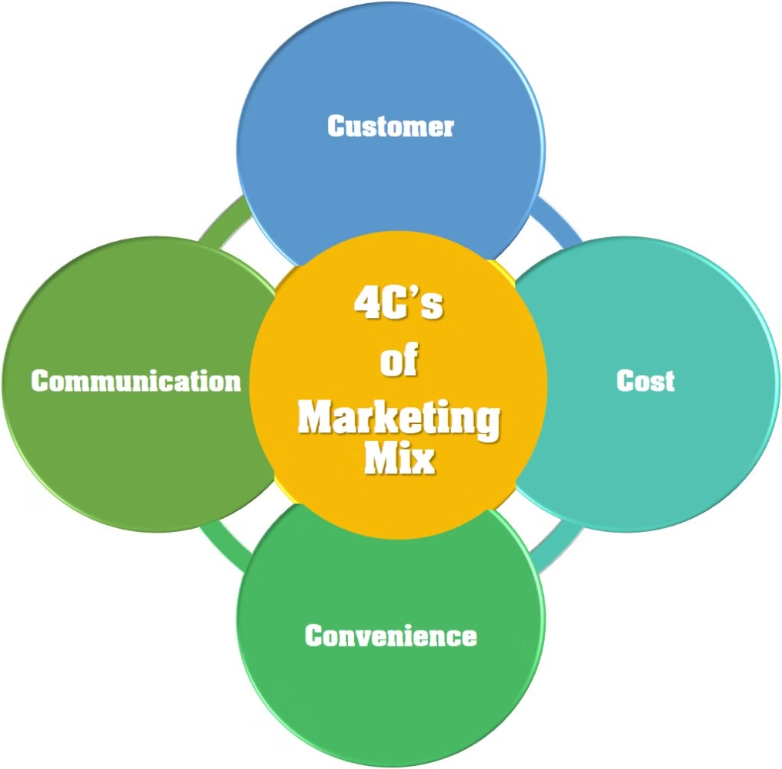
4 CS' Of marketing mix .

Slide 12
1- Customer solution
Consumer Needs: Research market trends to understand style preferences, materials, and customization options that consumers seek in shoes. Ex. Trendy, fashionable, and innovative
Customer Persona: Create detailed personas (e.g., young adults, fashion enthusiasts) to align marketing with target demographics.

Slide 13
2- Cost
Transparent Pricing:
Value Proposition
Special Offers:
Clearly communicate the pricing structure for customized shoes, including base prices and additional costs for premium materials or complex designs.
Highlight the value of customized shoes compared to mass-produced alternatives, emphasizing uniqueness and personal expression.
Implement targeted promotions and discounts, such as first-time buyer discounts, seasonal sales, and loyalty rewards programs to make the product more appealing.

Slide 14
Project pricing
- Estimated Cost
Minimum: EGP 37,600
Maximum: EGP 68,200
- Website Creation Cost (EGP 10,000-20,000)
Domain Name Registration: EGP 200-600/year
Web Hosting: EGP 500-1,500/year
Website Development:
Custom Development: EGP 5,000-15,000 (one-time)
SSL Certificate: EGP 200-500/year
- Email Setup Cost ( EGP 1,600-3,200)
Professional Email Hosting: EGP 400-800/year/user
- Business Materials Cost (EGP 26,000-45,000)
Equipment: Laptops (EGP 8,000-15,000), Printers (EGP 1,500-3,000)

Slide 15
Product price
-Estimate Price:
Minimum: EGP 1,550
Maximum: EGP 3,080
-Materials (EGP 1,050-2,000)
Base Shoes: EGP 800-1,500
Customization Materials: EGP 200-400
Packaging: EGP 50-100
-Editing (EGP 450-1,000)
Design Services: EGP 300-600
Production: EGP 150-400
-Delivery (EGP 50-80)
Local: EGP 50-80

Slide 16
Content Creation Costs
- Total Monthly Cost (14 Posts):
Minimum: EGP 4,400
Maximum: EGP 8,800
-Reels (Video Content):
EGP 500-1,000/reel
4 reels/month = EGP 2,000-4,000/month
-Photos (Static Images):
EGP 200-400/photo
6 photos/month = EGP 1,200-2,400/month
-GIFs (Animated Content):
EGP 300-600/GIF
4 GIFs/month = EGP 1,200-2,400/month

Slide 17
First 6 months' plan (Avg)
Cost (600 pairs) = 1,389,000 EGP
+Revenue (30%) = 416,700 EGP
=
Sales (600 pairs): 1,805,700 EGP
- Expenses
14 post per 6 months : 39,600 EGP + Platforms creation : 52,900 EGP = 92,500 EGP
Total revenue Contains:
Expenses " 30%" = 125,000 EGP
Media Buying Costs "30%" = 125,000 EGP
Profit "40%" = 166,700 EGP

Slide 18
3- Convenience
User-Friendly Platform:
Streamlined Customization:
Flexible Payment Options:
Ensure the website and mobile app are intuitive, allowing customers to easily design and order their customized shoes.
Simplify the customization process with easy-to-use design tools and a clear step-by-step guide.
Offer multiple payment methods
Efficient Delivery:
Provide reliable and fast shipping options, with real-time tracking and easy return policies to enhance customer convenience.

Slide 19
4- Communication
1
Engaging Content:
2
Interactive Channels:
Create and share engaging content across social media such as Instagram, TikTok, and Facebook , email newsletters.
Maintain active and responsive communication channels on social media, and dedicated customer service lines to address queries and concerns promptly.
3
Personalized Marketing:
Use data-driven marketing to send personalized recommendations and offers to customers based on their preferences and purchase history.

Slide 20
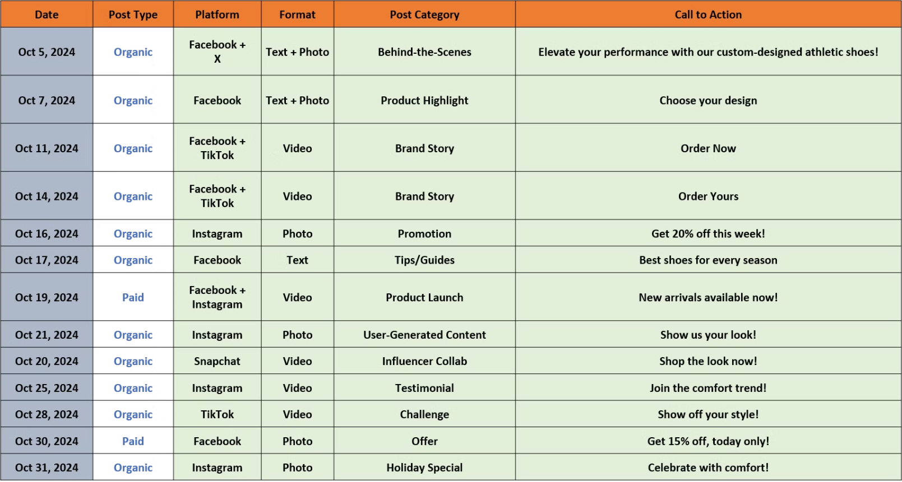
Content Calendar (Oct)

Slide 21
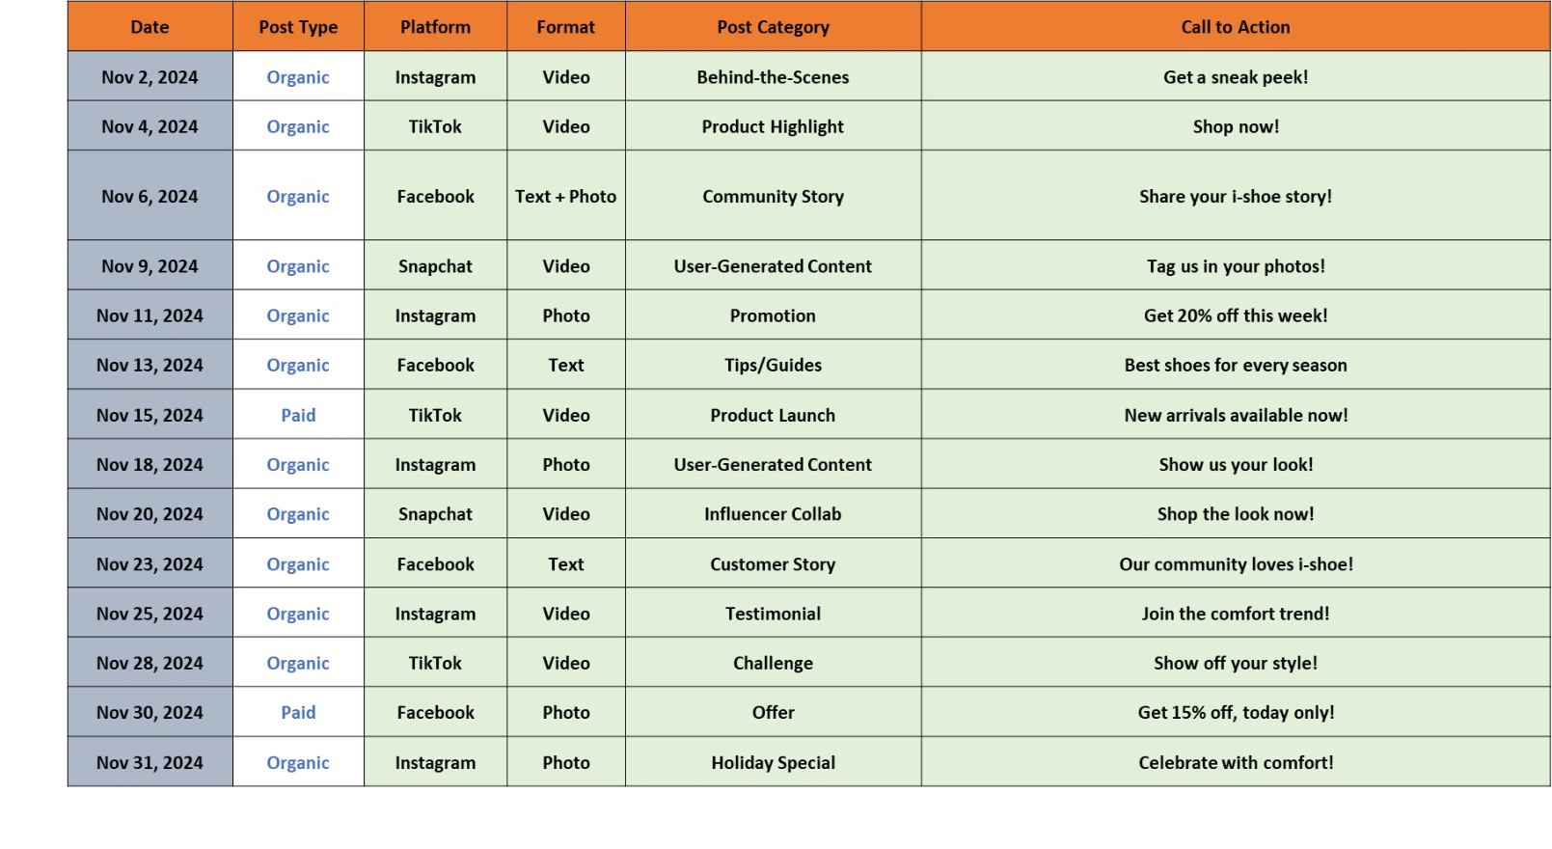
Content Calendar (Nov)

Slide 22
Control and KPI:
To control and set Key Performance (KP) benchmarks we define and track metrics such as visits rate, conversion rate, and other KPIs. Below are common benchmarks and how to manage them.
Website Traffic (Visit Rate):
Track visitor numbers using Google Analytics. Aim for 10,000+ visitors/month by leveraging organic content and paid campaigns on Instagram and TikTok.
Conversion Rate
Focus on a 2% - 3% conversion rate by optimizing product pages for mobile, adding clear CTAs, and offering limited-time promotions. Track with Shopify or your eCommerce platform.
Customer Retention
Maintain a 20% retention rate by engaging customers with email newsletters and loyalty discounts. Use CRM tools to track and improve repeat purchases.
Return on Ad Spend (ROAS)
Ensure ads on Instagram/TikTok yield a 4:1 ROAS by refining audience targeting and ad creatives.

Slide 23
How to improve Ads Reach/Impression
1- Refine Target Audience: By 20% by targeting lookalike audiences based on your top 10% most loyal customers. Track a 10% CTR improvement within 30 days.
2- Optimize Ads: Use new image ads and 3 videos (15-30 sec) focusing on product shots and unique features. Track post-ad CTR and engagement (likes, shares) for each format, aiming for a 3% increase.
3- Influencer Marketing: Boost awareness and by 10% through influencer partnerships. Partner with 2 fitness/fashion/influencers/celebrity to gain (20k+ followers, 4% engagement) to measure reach and engagement uplift.

Slide 24
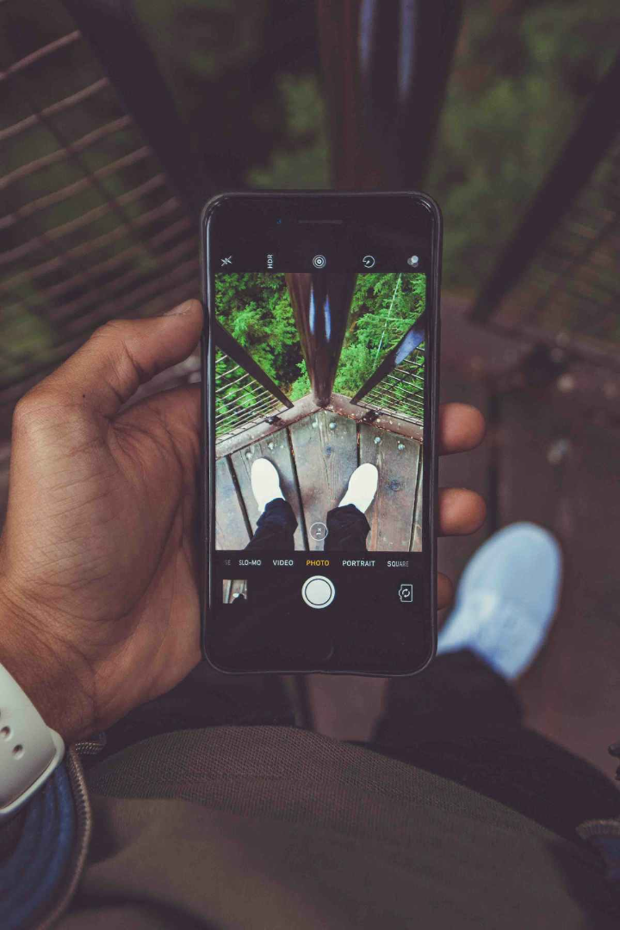
Thank you. Questions!

